Slide 1
Algorithmic Bias
Implicit biases, senses, sources, solutions

Slide 2
Outline:
Examples of algorithmic bias.
Understanding bias structure.
Potential solutions.
Summary.

Slide 3

Let’s start with you. . .
What do you think is algorithmic bias, human bias and what are the differences?

Slide 4
Part 1: example of algorithmic bias

Slide 5
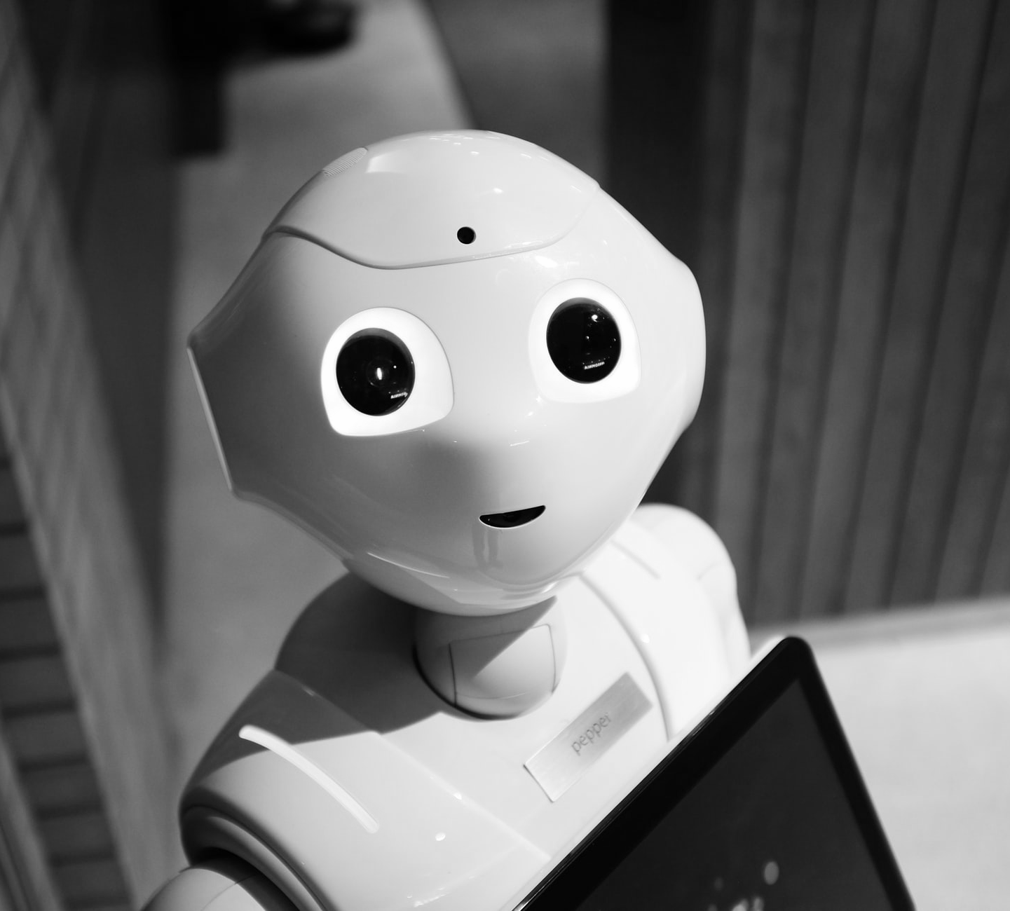
Microsoft’s Tay:
AI chatbot released in 2016
Learned from Twitter interactions

Slide 6
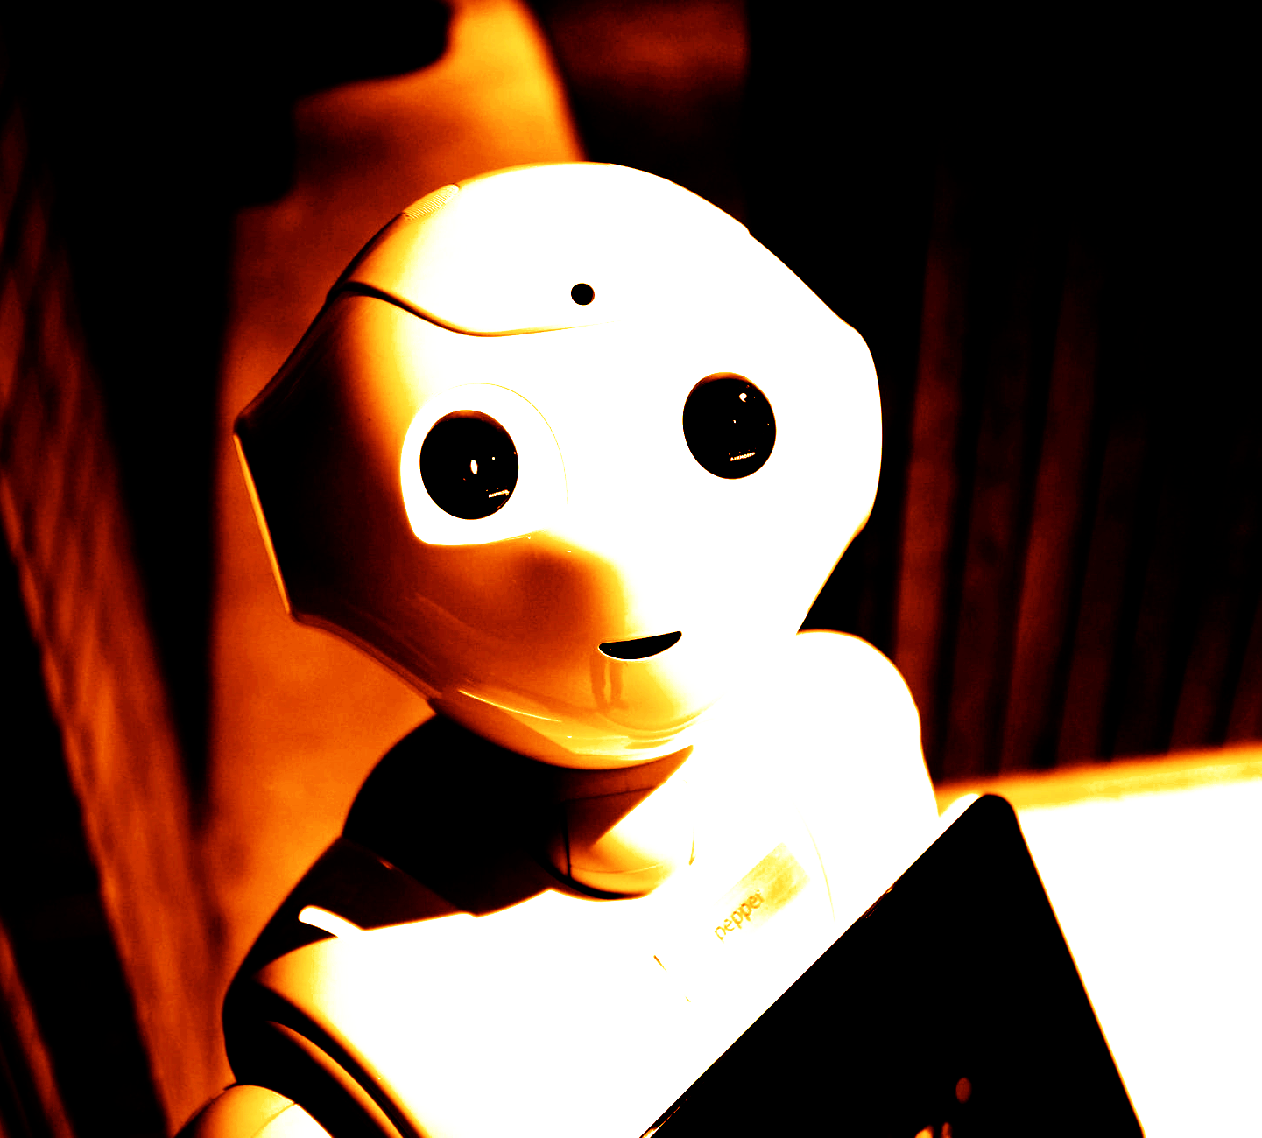
Microsoft’s Tay:
AI chatbot released in 2016
Learned from Twitter interactions
Within 16 hours: racist, sexist, inflammatory content
Key insight: Inherited biases from training data

Slide 7

Word Embedding Case
Common crawl analysis (840B words)
Replicated human implicit bias:
Female names with family vs career
African-American names with unpleasant words
Male names with science/math

Slide 8
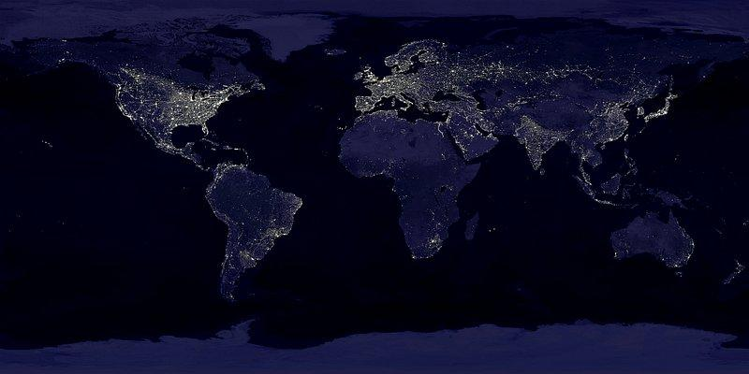
Real world impact examples
St. George Hospital medical school (1988)
Rejected women and non-european names.
Google Ad-targeting (2015)
Showed high-paying job ads more to male
COMPAS recidivism prediction
Higher false positive rates for black defendants

Slide 9

Your view. . .
Can algorithmic bias be completely eliminated if data reflects societal biases? Should we even try?

Slide 10
Part 2: Understanding bias structure

Slide 11
Key definitions
Systematic deviation in algorithm output / performance relative to some norm
Multiple types:
Statistical bias
Moral bias
Social bias

Slide 12
Important characteristics
Not just code / mathematics
Depends on
Domain of application
Goals of algorithmic use
Contextual factors
Bias exists anywhere induction does

Slide 13
Similarities between algorithmic and cognitive bias
Both can emerge from seemingly innocent information processing
Neither requires explicit representation of biased rules
Both can operate through proxy attributes that correlate with sensitive characteristics
Example: KNN

Slide 14
The proxy problem
Truly implicit bias
Bias without explicit representation
Emerges from innocuous patterns
Resistant to simple filtering
Hard to counter-example
Proxy Problem
Programs use proxy attributes
Example: zip codes as proxy for race
Makes bias hard to eliminate
Similar to human implicit biases

Slide 15
Your view. . .
If biases can emerge from seemingly neutral processes, what does this mean for accountability and responsibility in AI system?

Slide 16
Part 3: Potential solutions

Slide 17
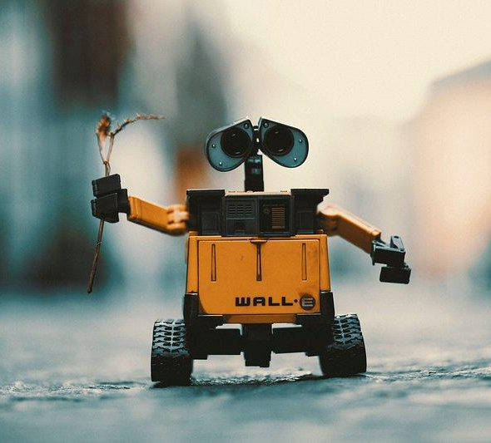
Key challenges:
Impossibility results for fairness metrics
Tradeoff between accuracy and fairness
Need for both technical and social solutions

Slide 18
Your view. . .
What are the ethical implications of accuracy-fairness tradeoffs? Should we accept less accurate systems to achieve more fairness?
Who gets to make these decisions

Slide 19
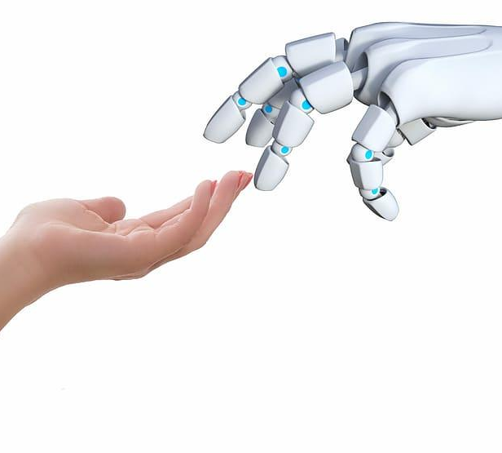
Mitigation strategies:
Pre-processing training data
(Changing social patterns)
Modifying learning algorithms
Post-processing outputs
Systemic changes needed

Slide 20
Your view. . .
How can we then eliminate the algorithmic bias?

Slide 21

Summarizing…

Slide 22
Key points
Bias is intrinsic in inductive reasoning
There is no purely algorithmic solution
Need integrated technical and social approaches

Slide 23
Thank you!
Alex Chilton, Lara Nonis
From: Algorithmic bias: on the implicit biases of social technology (Gabbrielle M. Johnson); Algorithmic bias: Senses, sources, solutions (Sina Fazelpour, David Danks)
Fonts used: Roboto Mono and Gugi; Presentation Template: SlidesMania ; Images: Unsplash

